Slide 1
Newton-Raphson Method
by Dr. Md. Rajibul Islam CSE, UAP
*
‹#›

Slide 2
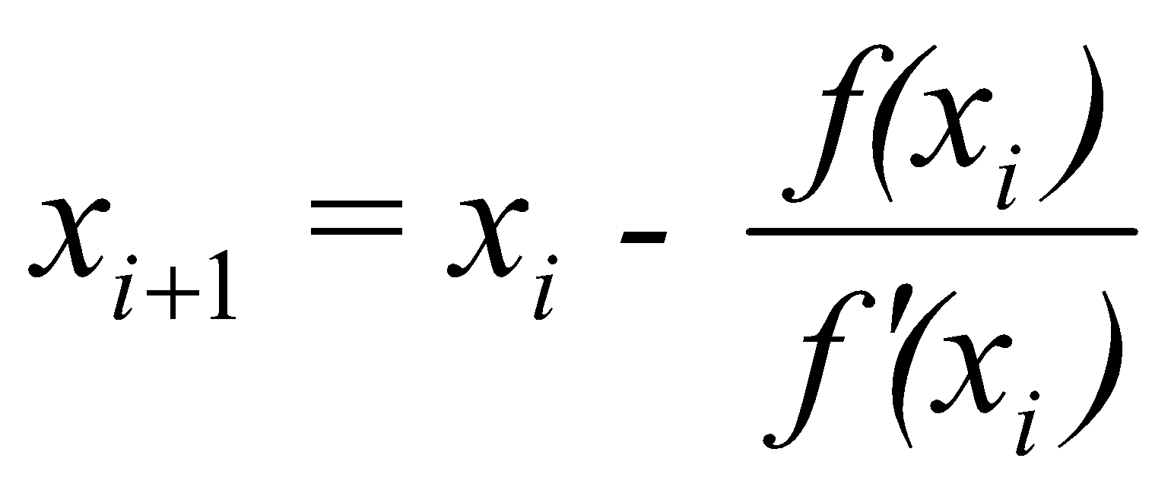
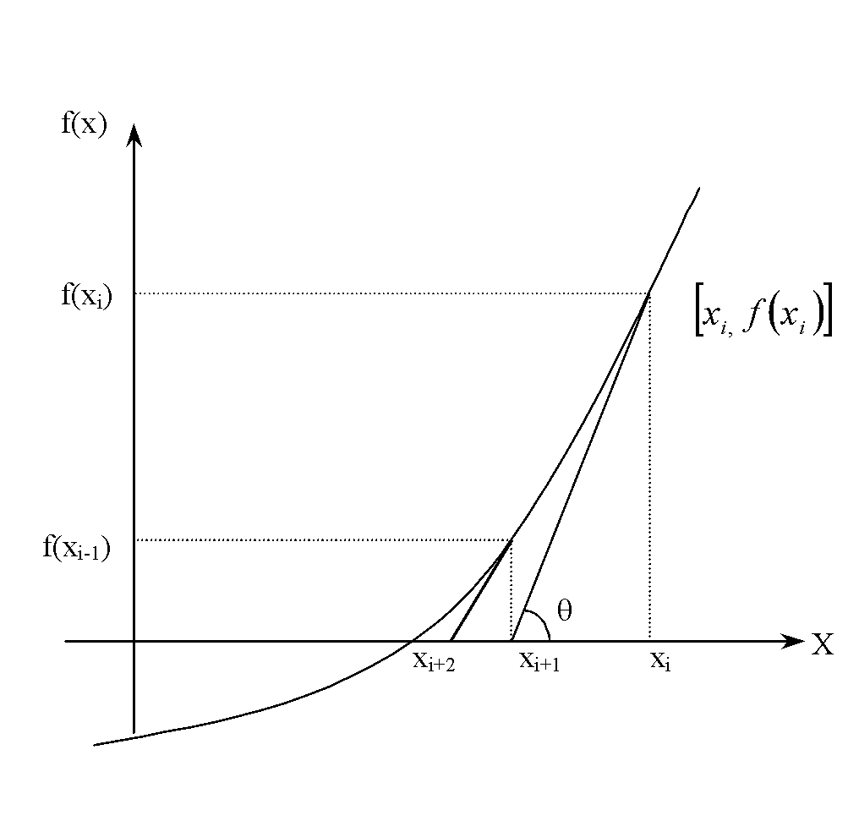
Newton-Raphson Method
Continuously draw a tangent line to get a closer value of the root
Newton-Raphson formula
Figure 1 Geometrical illustration of the Newton-Raphson method.
‹#›

Slide 3
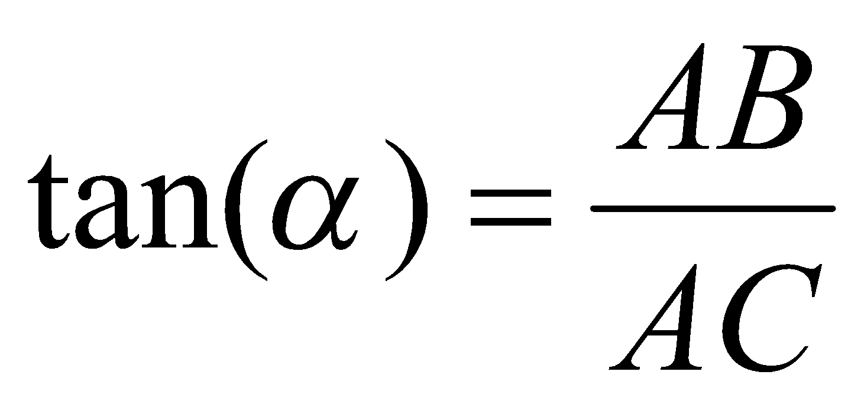
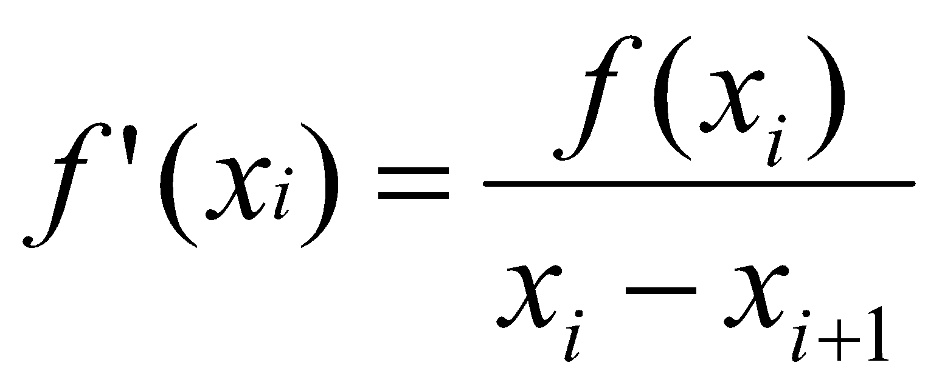
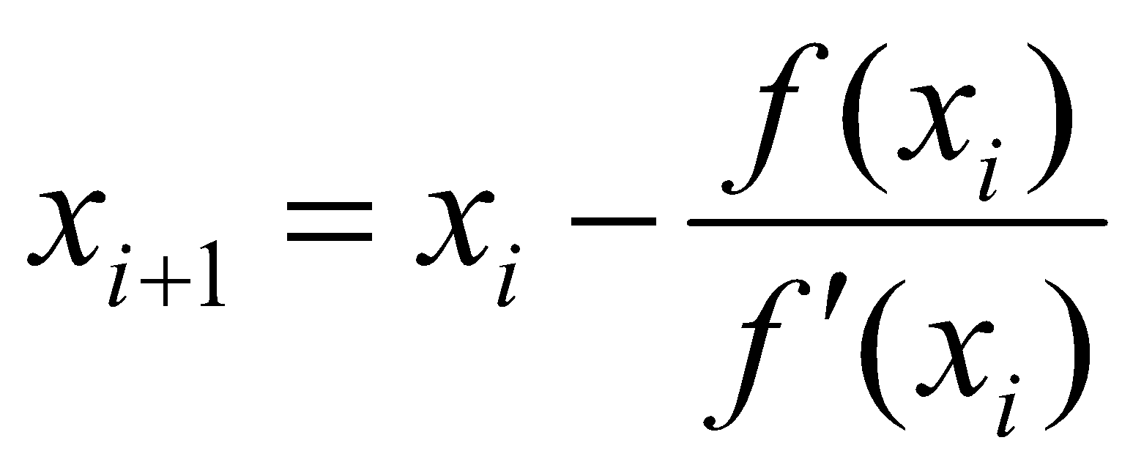
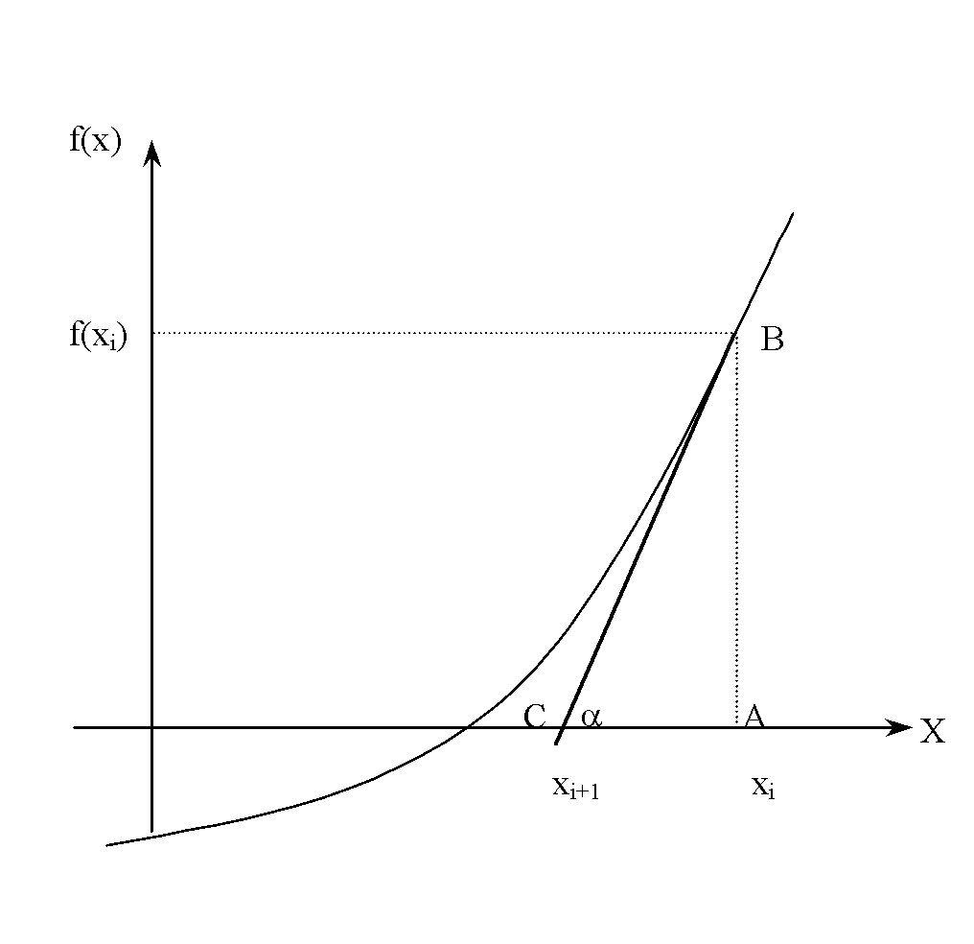
Derivation
Figure 2 Derivation of the Newton-Raphson method.
‹#›

Slide 4
Algorithm for Newton-Raphson Method
‹#›

Slide 5
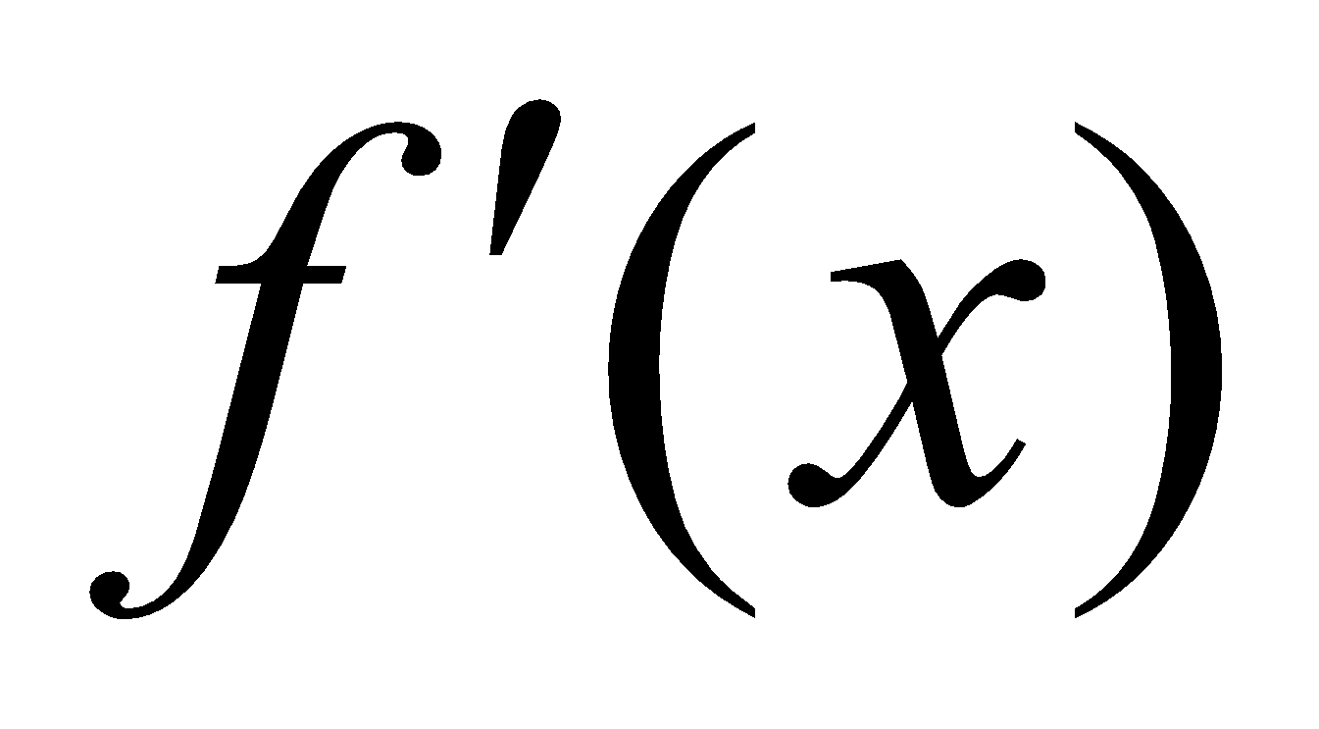
Step 1
Calculate
symbolically.
‹#›

Slide 6
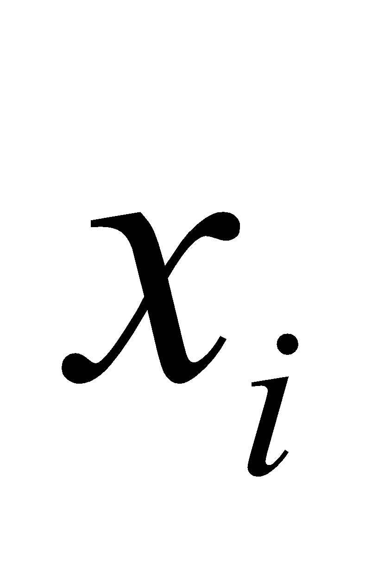
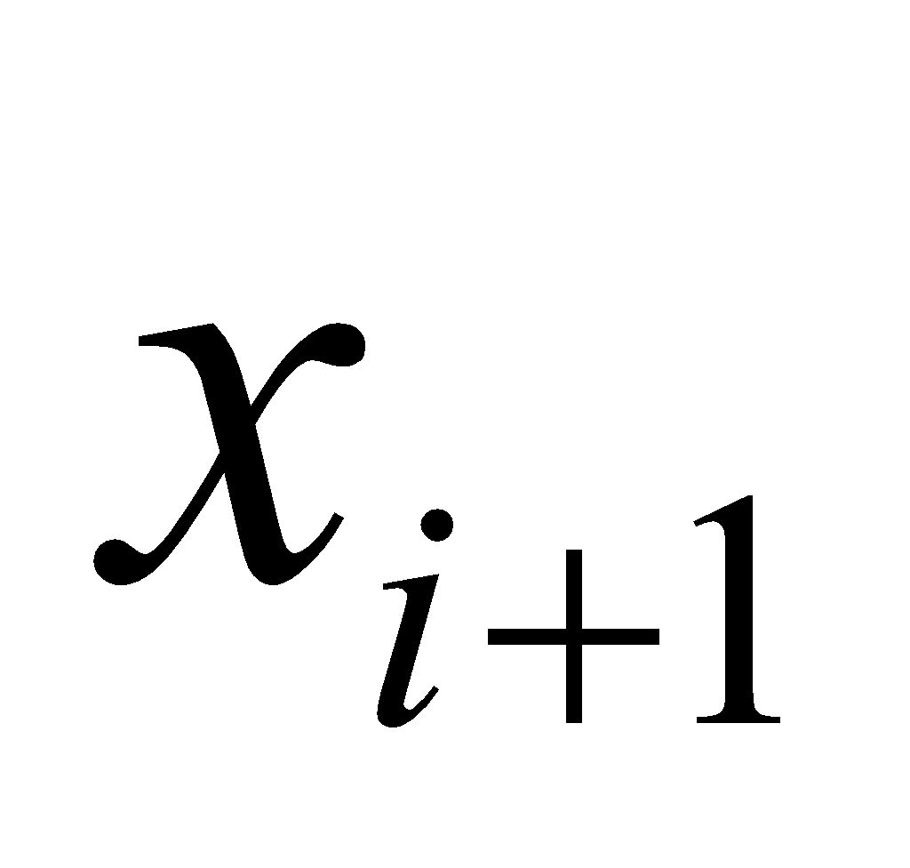
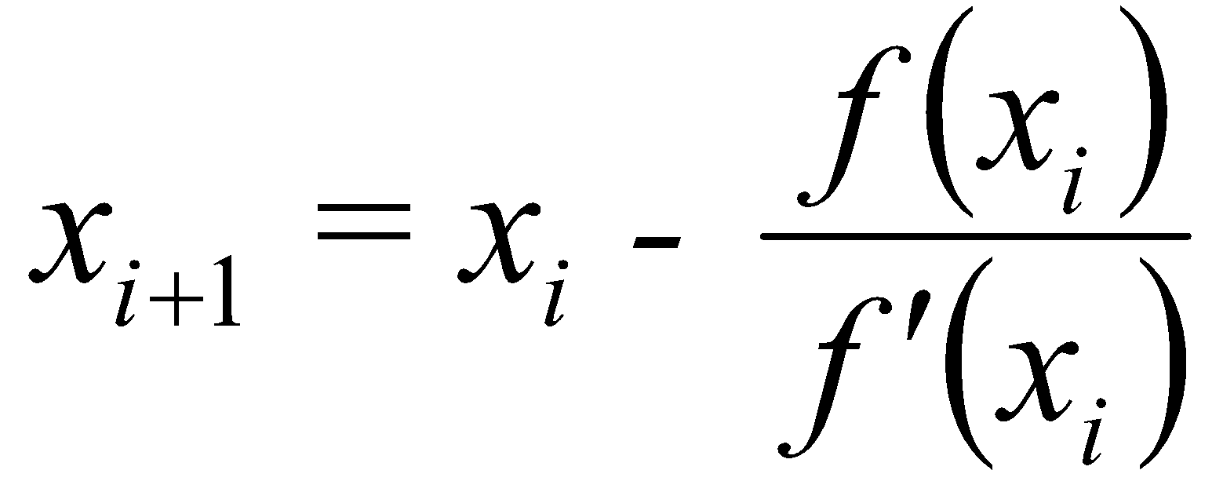
Step 2
Use an initial guess of the root, , to estimate the new value of the root, , as
‹#›

Slide 7
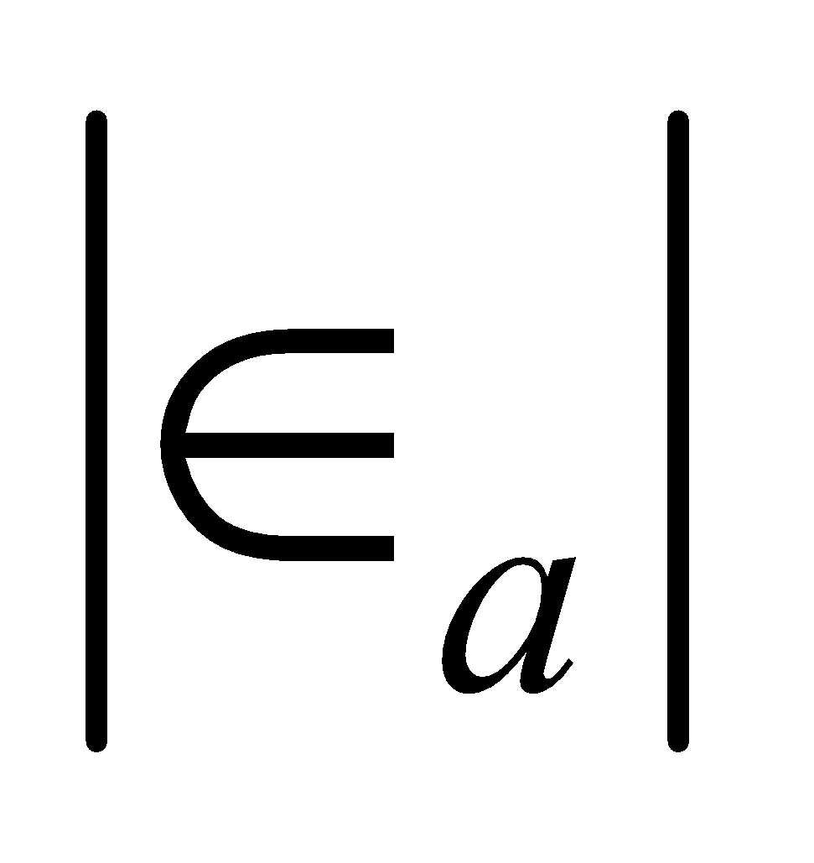
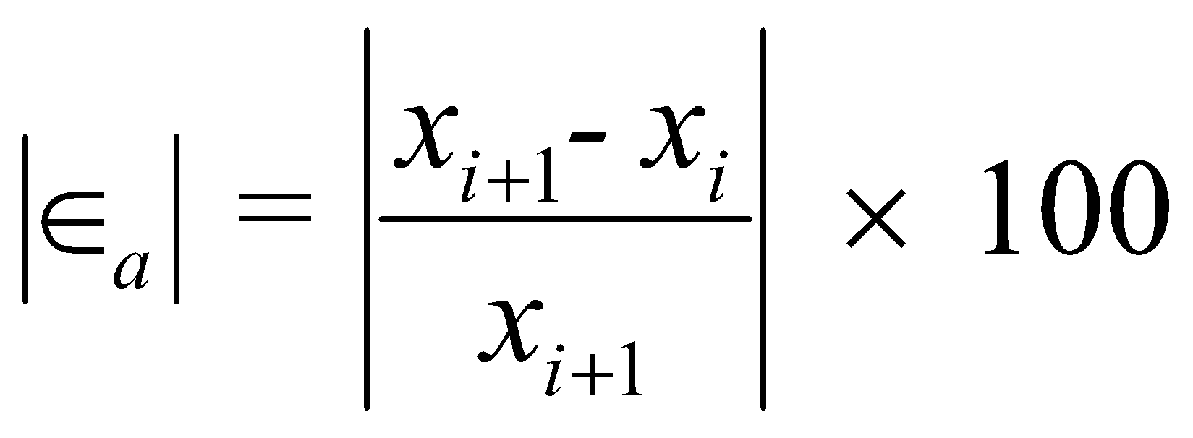
Step 3
Find the absolute relative approximate error as
‹#›

Slide 8
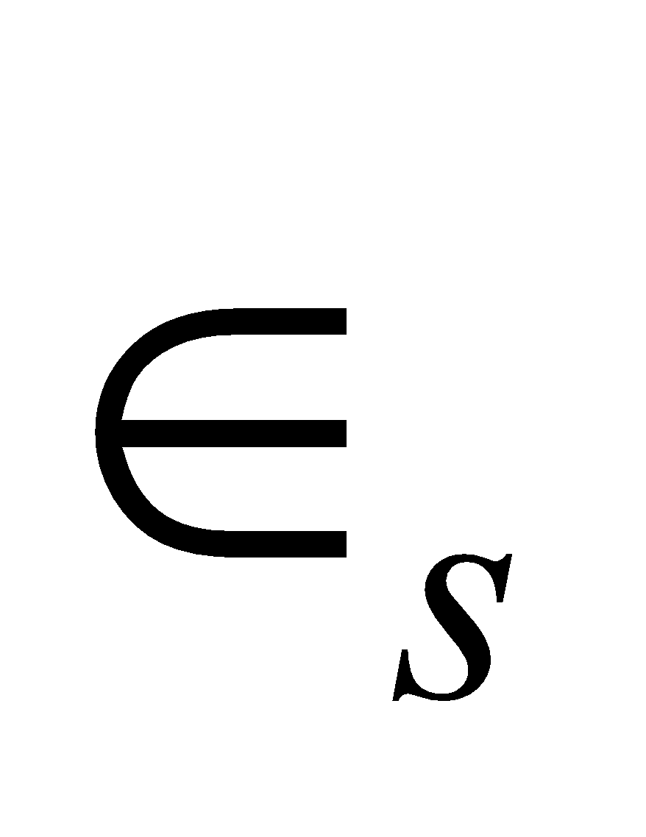
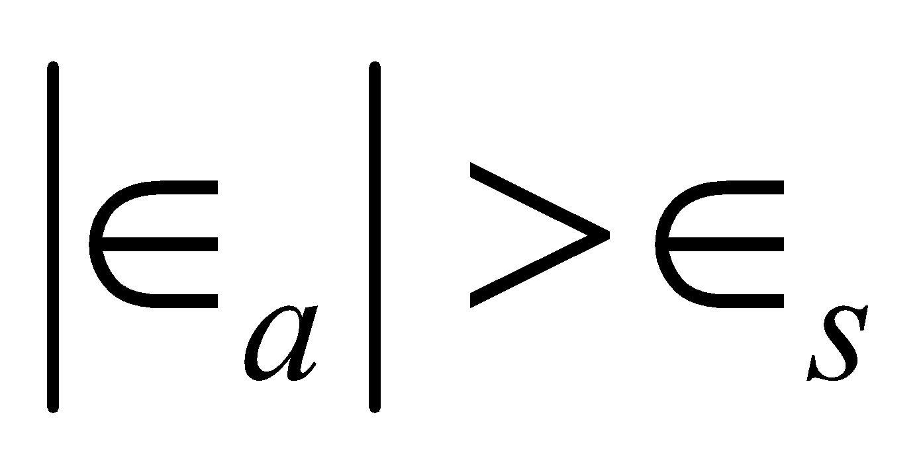
Step 4
Compare the absolute relative approximate error with the pre-specified relative error tolerance .
Also, check if the number of iterations has exceeded the maximum number of iterations allowed. If so, one needs to terminate the algorithm and notify the user.
Yes
Go to Step 2 using new estimate of the root.
Is ?
No
Stop the algorithm
‹#›

Slide 9
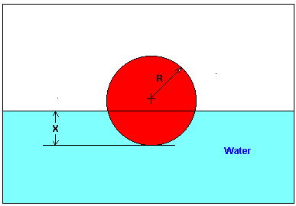
Example 1
You are working for ‘DOWN THE TOILET COMPANY’ that makes floats for ABC commodes. The floating ball has a specific gravity of 0.6 and has a radius of 5.5 cm. You are asked to find the depth to which the ball is submerged when floating in water.
Figure 3 Floating ball problem.
‹#›

Slide 10
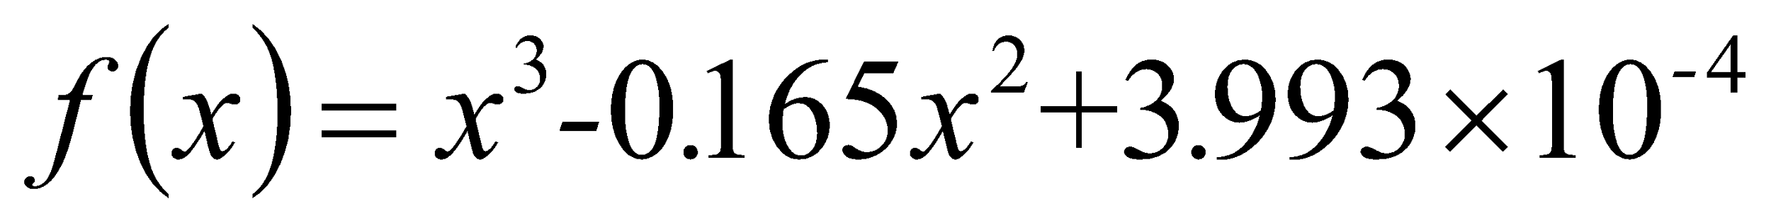

Example 1 Cont.
The equation that gives the depth x in meters to which the ball is submerged under water is given by
Figure 3 Floating ball problem.
Use the Newton’s method of finding roots of equations to find
the depth ‘x’ to which the ball is submerged under water. Conduct three iterations to estimate the root of the above equation.
The absolute relative approximate error at the end of each iteration, and
The number of significant digits at least correct at the end of each iteration.
‹#›

Slide 11
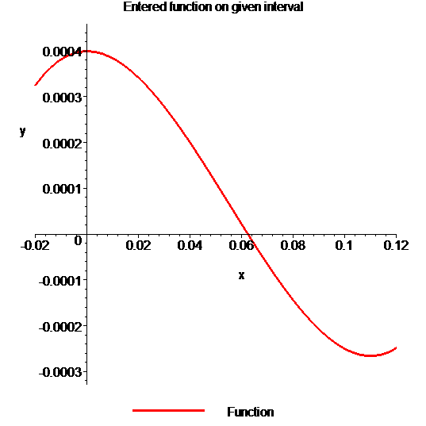

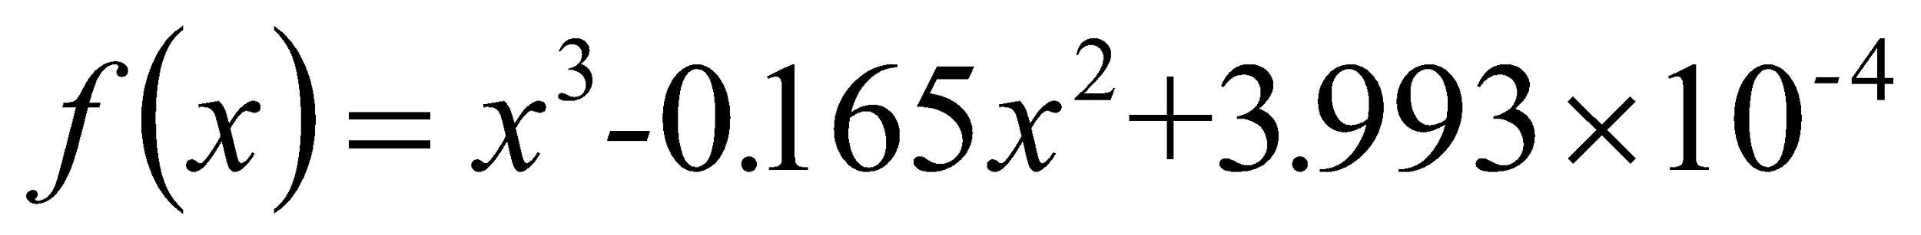
Example 1 Cont.
Solution
To aid in the understanding of how this method works to find the root of an equation, the graph of f(x) is shown to the right,
where
Figure 4 Graph of the function f(x)
‹#›

Slide 12
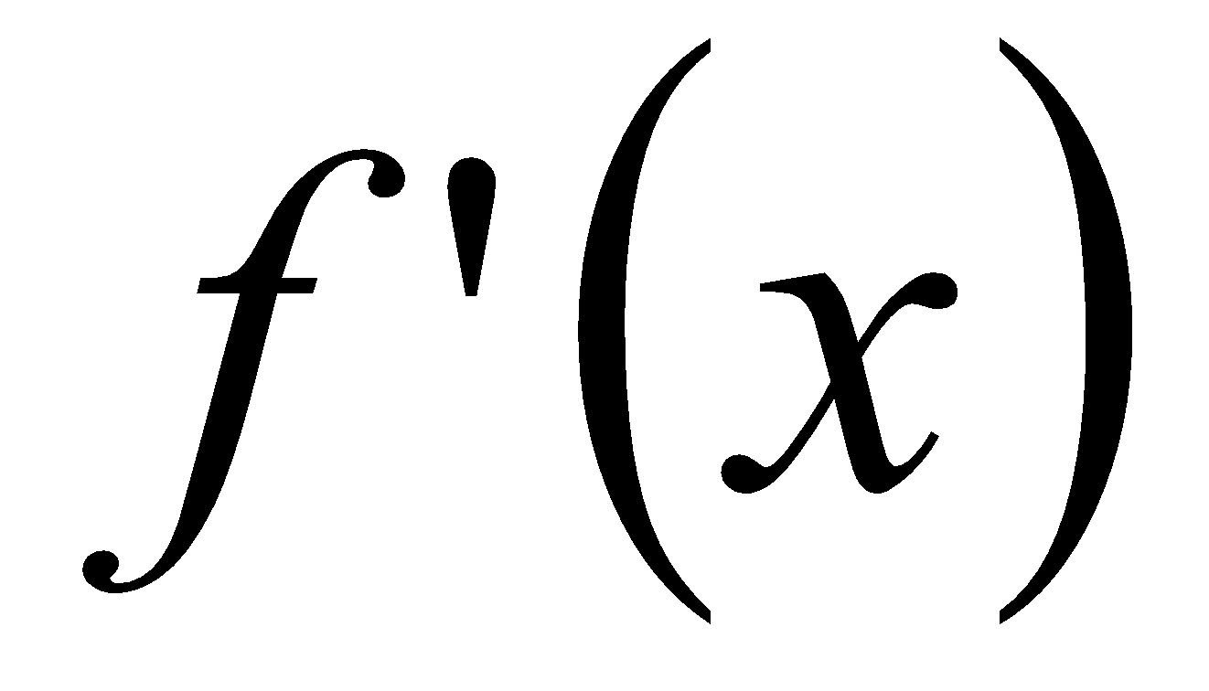
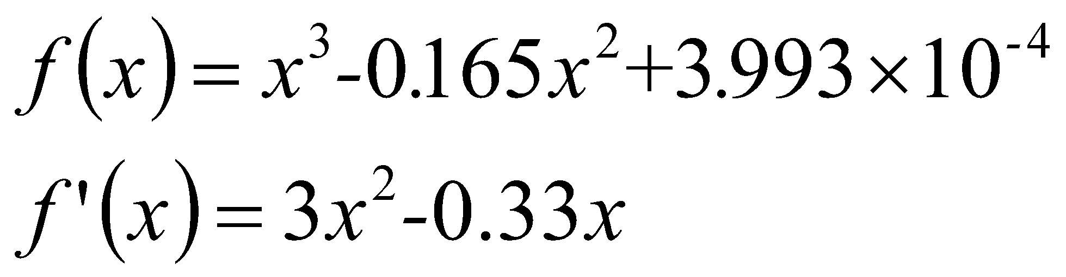
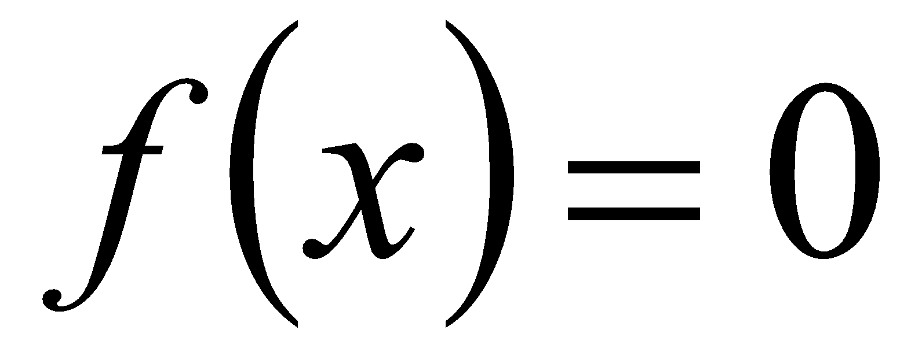
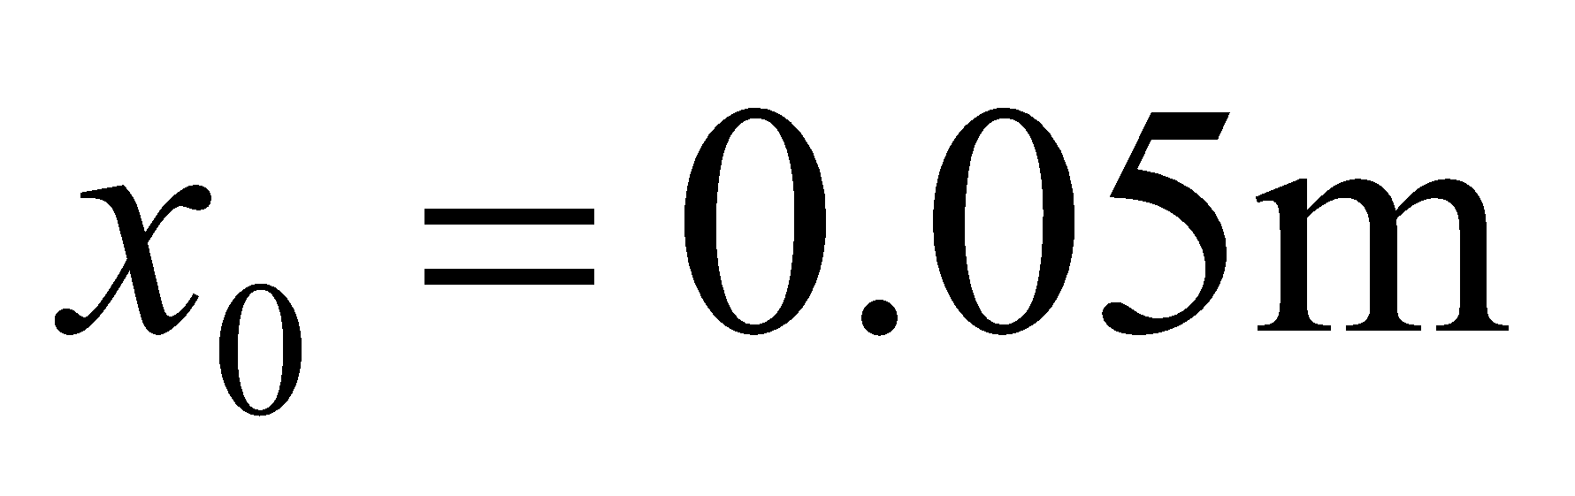
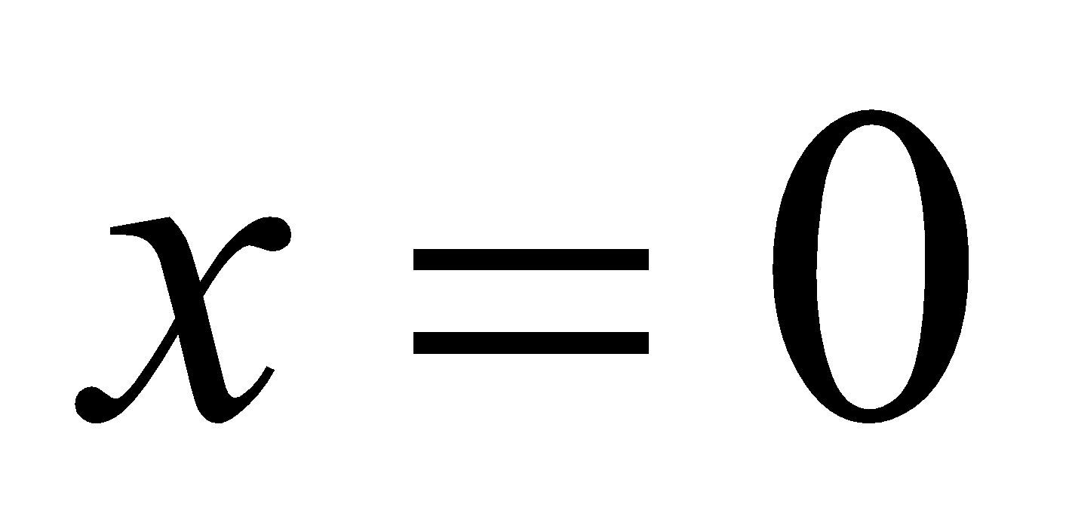
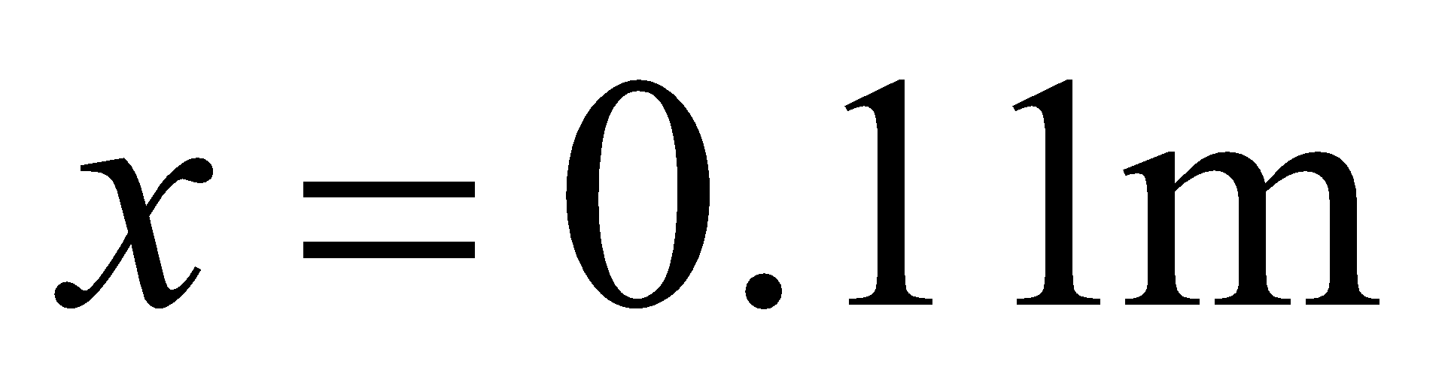
Example 1 Cont.
Solve for
Derivative of f(x)
Let us assume the initial guess of the root of is . This is a reasonable guess (discuss why
and are not good choices) as the extreme values of the depth x would be 0 and the diameter (0.11 m) of the ball.
‹#›

Slide 13
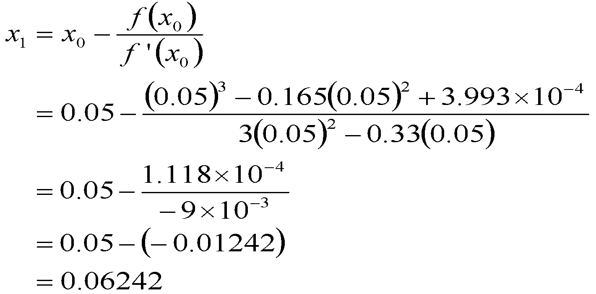
Example 1 Cont.
Iteration 1
The estimate of the root is
‹#›

Slide 14
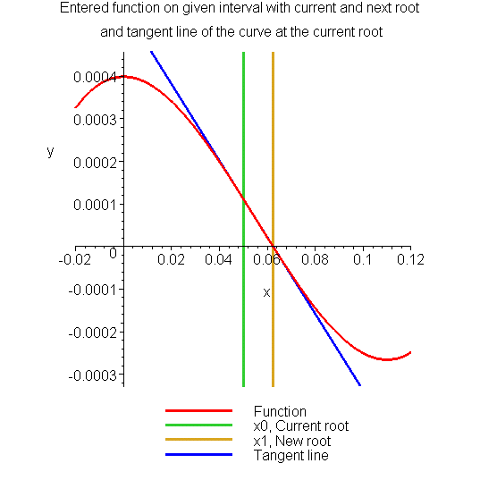
Example 1 Cont.
Figure 5 Estimate of the root for the first iteration.
‹#›

Slide 15
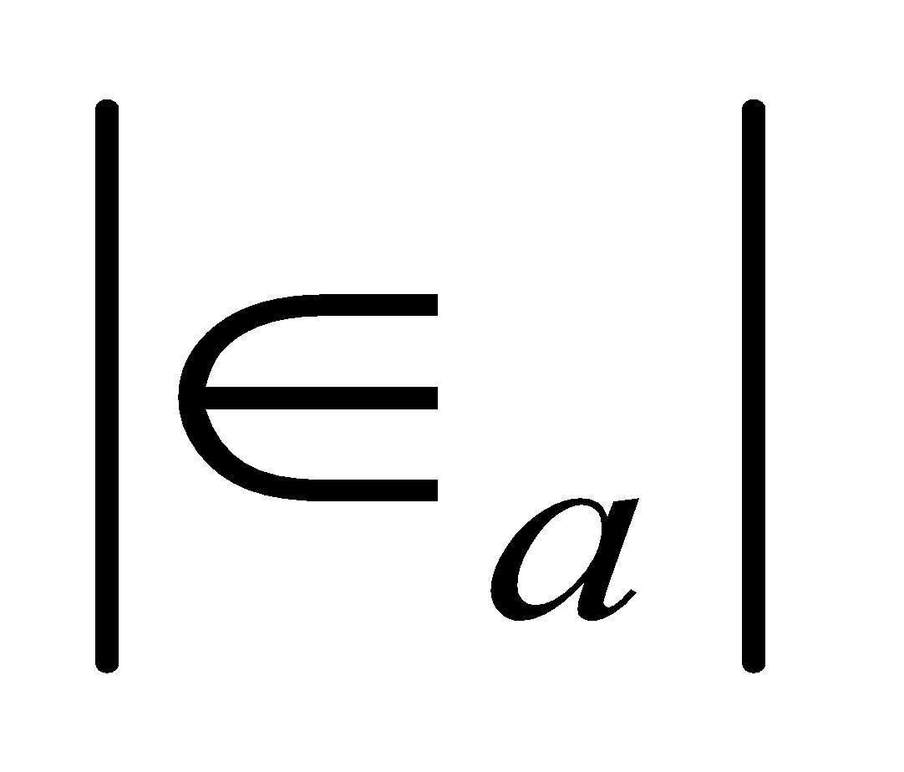
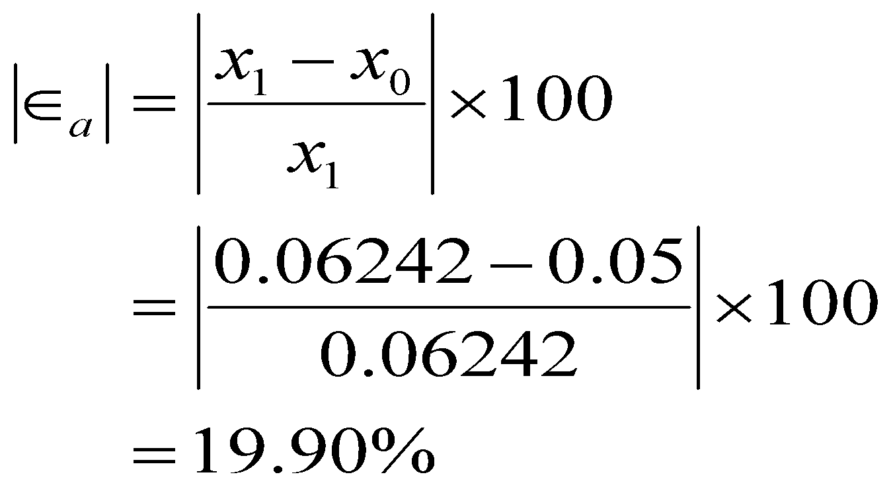
Example 1 Cont.
The absolute relative approximate error at the end of Iteration 1 is
The number of significant digits at least correct is 0, as you need an absolute relative approximate error of 5% or less for at least one significant digits to be correct in your result.
‹#›

Slide 16
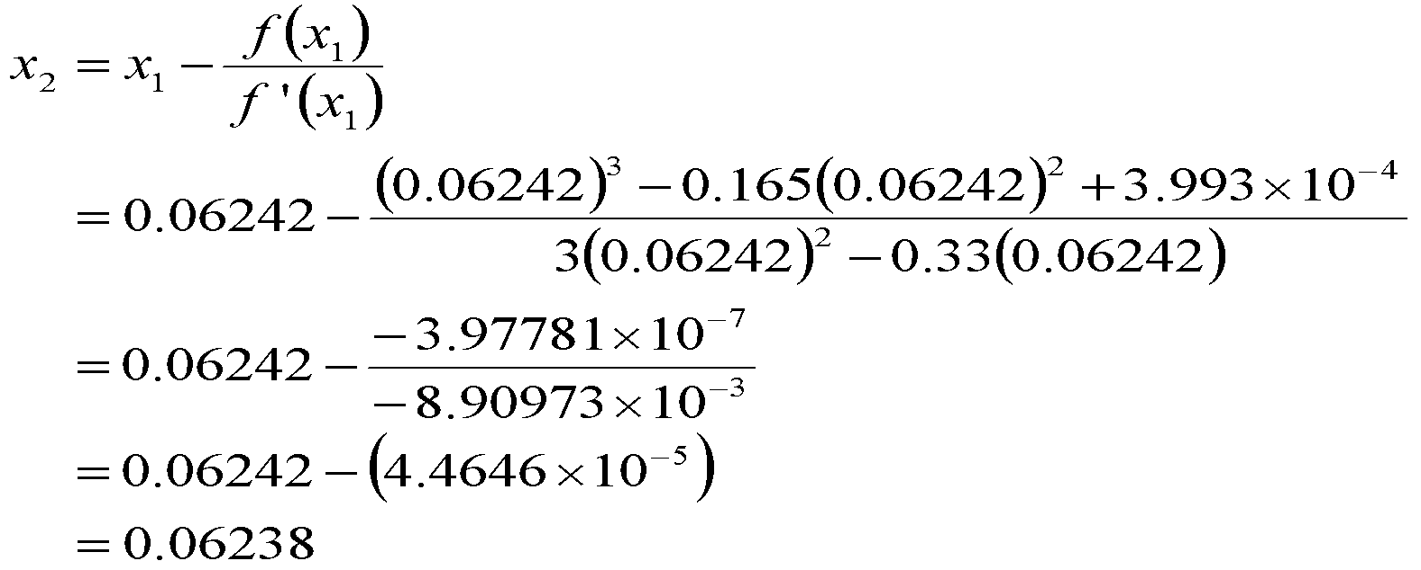
Example 1 Cont.
Iteration 2
The estimate of the root is
‹#›

Slide 17
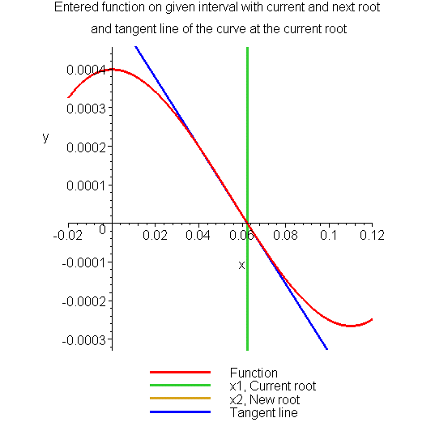
Example 1 Cont.
Figure 6 Estimate of the root for the Iteration 2.
‹#›

Slide 18
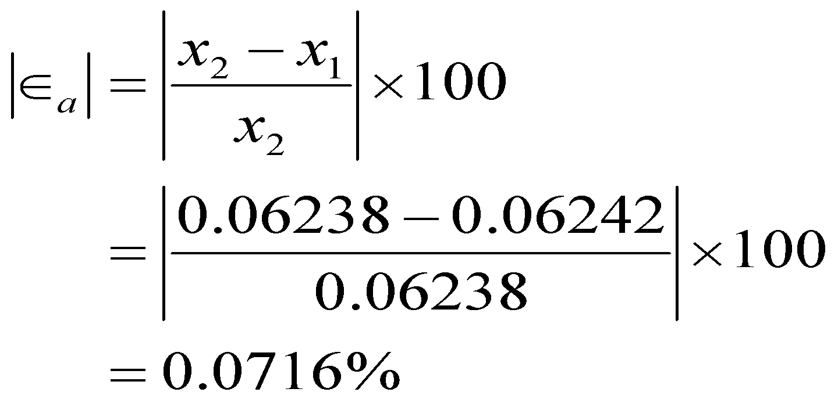
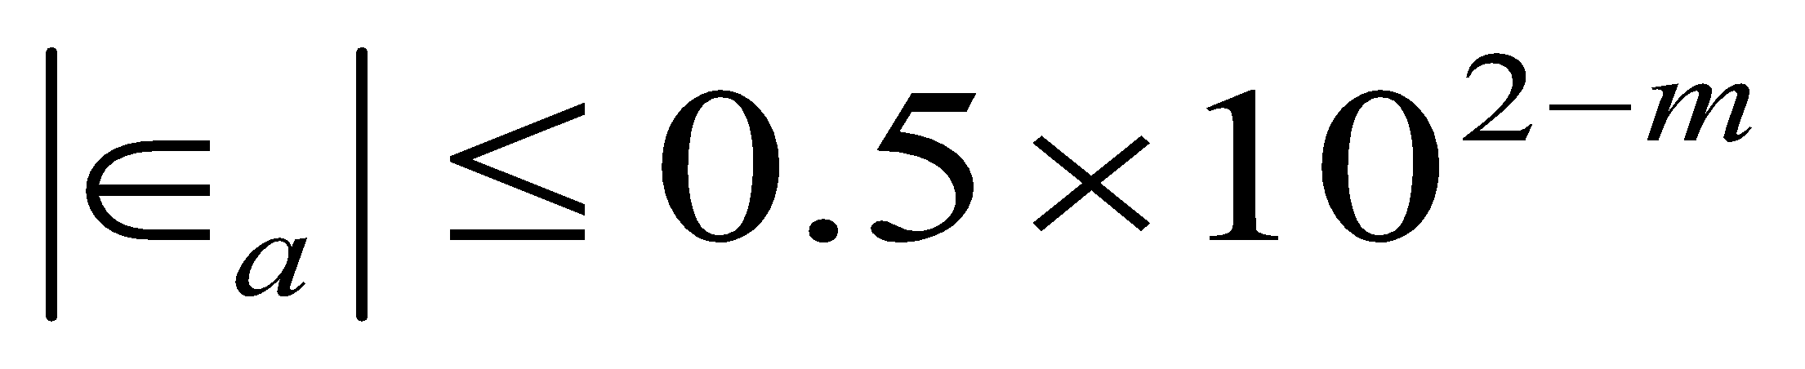
Example 1 Cont.
The absolute relative approximate error at the end of Iteration 2 is
The maximum value of m for which is 2.844. Hence, the number of significant digits at least correct in the answer is 2.
‹#›

Slide 19
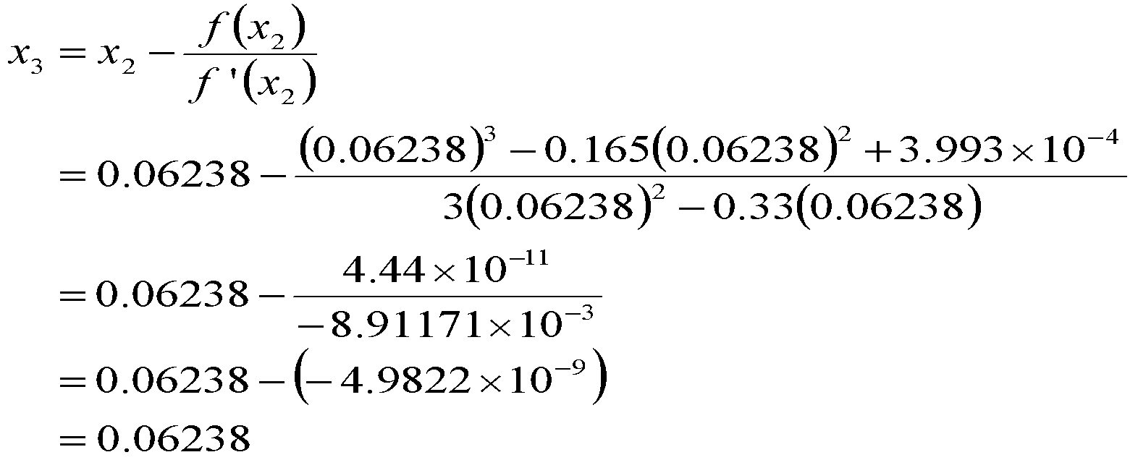
Example 1 Cont.
Iteration 3
The estimate of the root is
‹#›

Slide 20
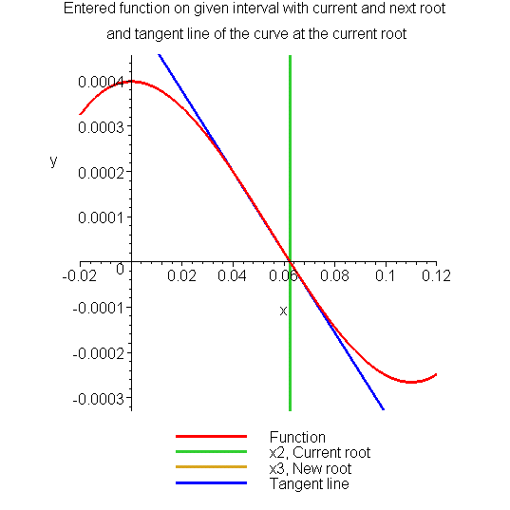
Example 1 Cont.
Figure 7 Estimate of the root for the Iteration 3.
‹#›

Slide 21
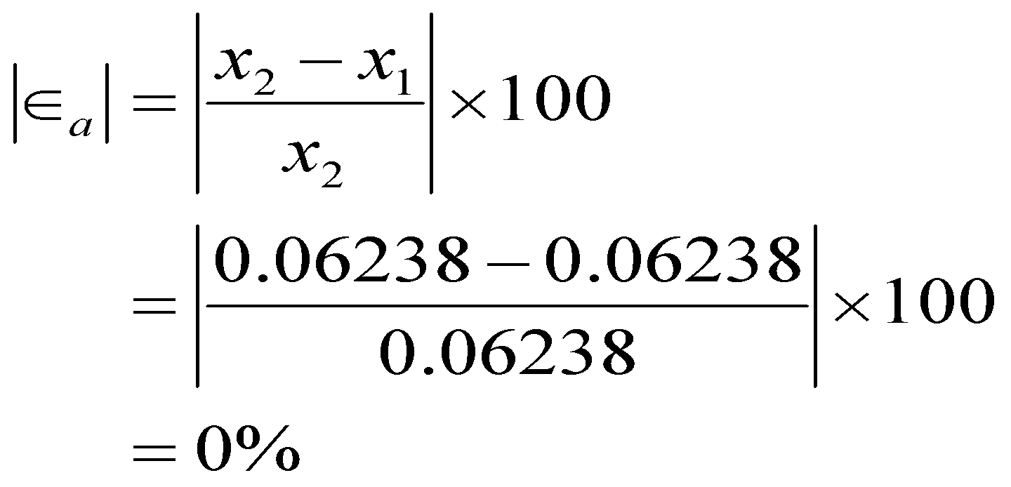
Example 1 Cont.
The absolute relative approximate error at the end of Iteration 3 is
The number of significant digits at least correct is 4, as only 4 significant digits are carried through all the calculations.
‹#›

Slide 22
Advantages
Converges fast (quadratic convergence), if it converges.
Requires only one guess
‹#›

Slide 23
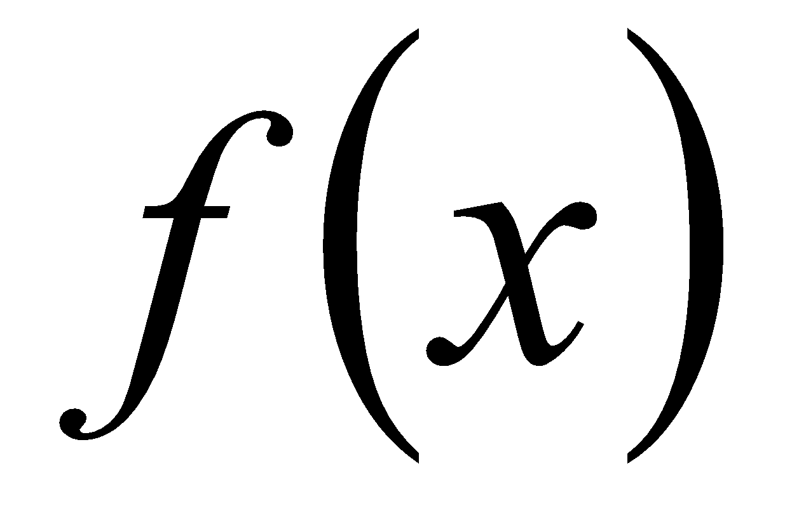
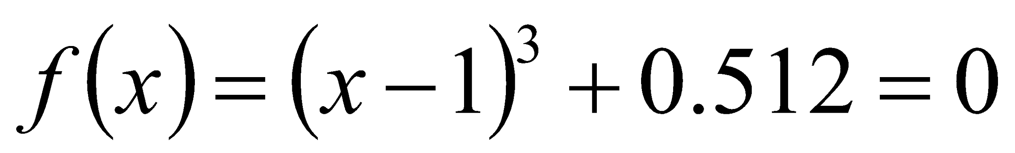
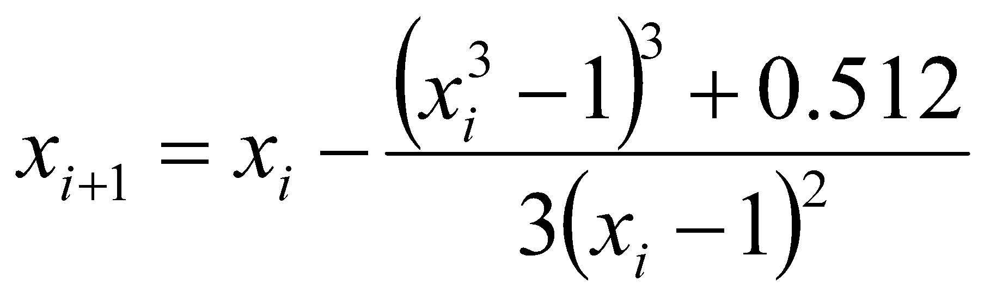
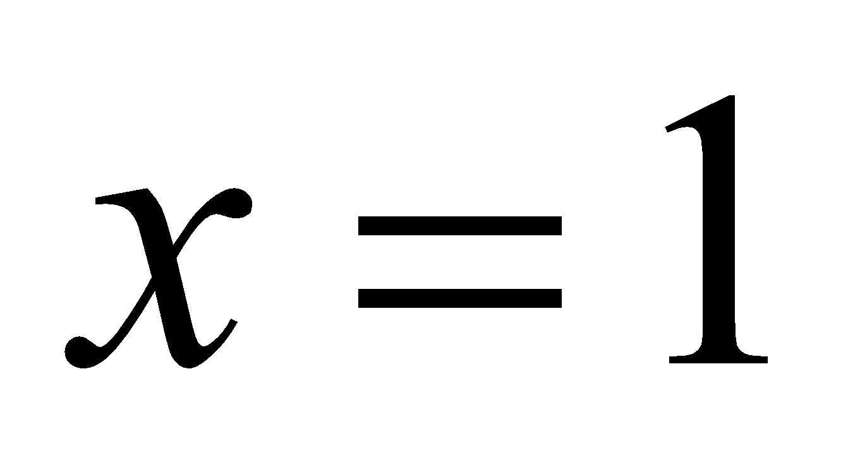
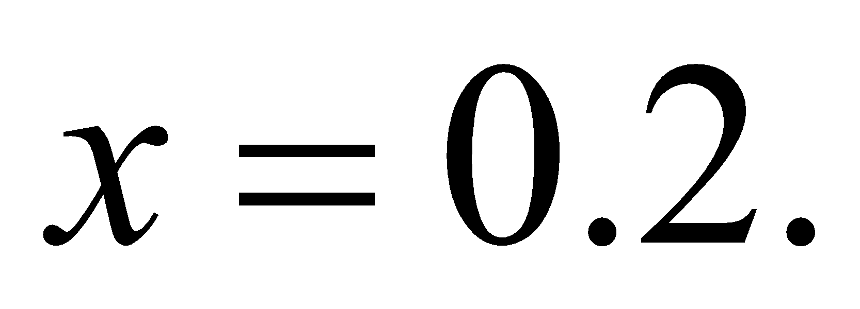
Drawbacks
Divergence at inflection points
Selection of the initial guess or an iteration value of the root that is close to the inflection point of the function may start diverging away from the root in there Newton-Raphson method.
For example, to find the root of the equation .
The Newton-Raphson method reduces to .
Table 1 shows the iterated values of the root of the equation.
The root starts to diverge at Iteration 6 because the previous estimate of 0.92589 is close to the inflection point of .
Eventually after 12 more iterations the root converges to the exact value of
‹#›

Slide 24
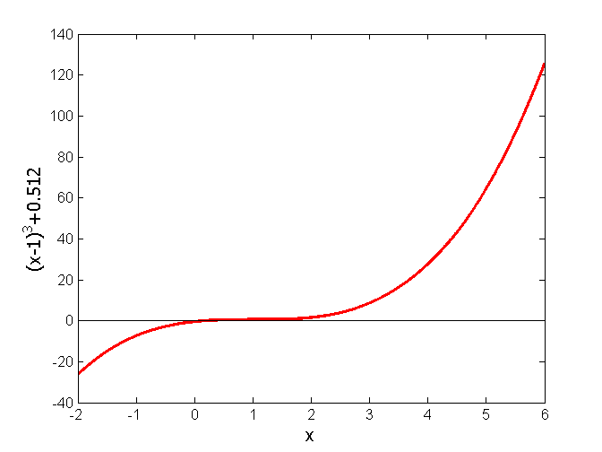
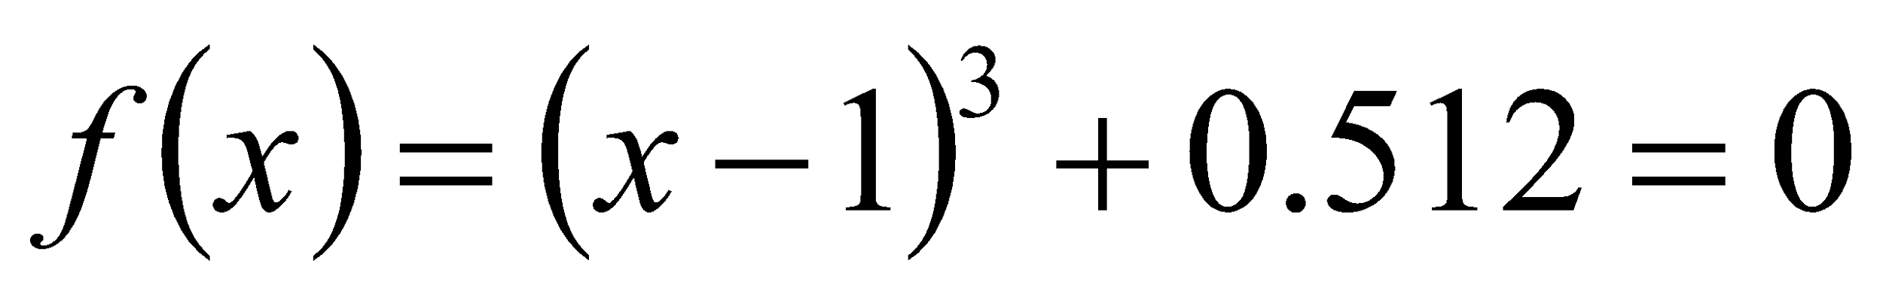
Drawbacks – Inflection Points
Table 1 Divergence near inflection point.
Iteration Number | x_{i}
0 | 5.0000
1 | 3.6560
2 | 2.7465
3 | 2.1084
4 | 1.6000
5 | 0.92589
6 | −30.119
7 | −19.746
18 | 0.2000
Figure 8 Divergence at inflection point for
‹#›

Slide 25
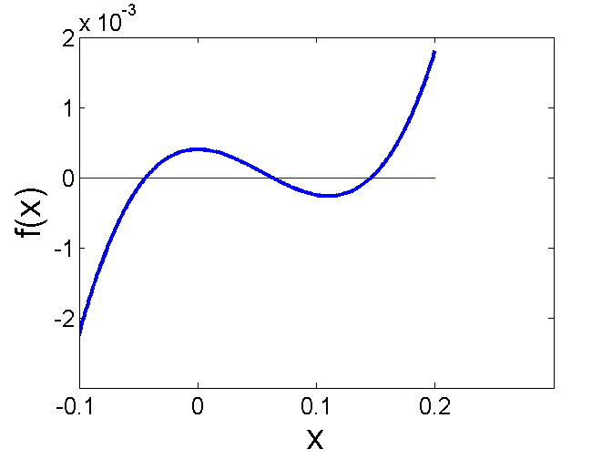
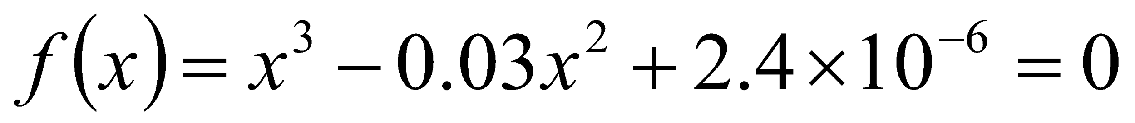
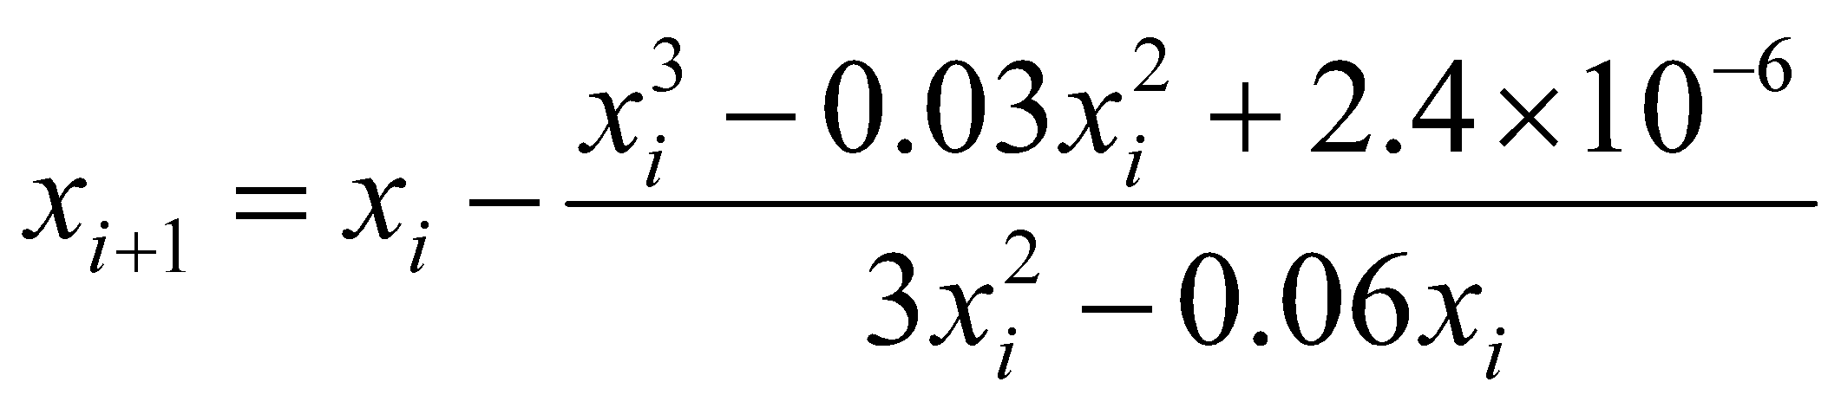
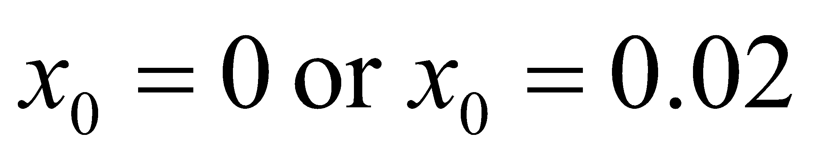
Drawbacks – Division by Zero
Division by zero
For the equation
the Newton-Raphson method reduces to
For , the denominator will equal zero.
Figure 9 Pitfall of division by zero or near a zero number
‹#›

Slide 26
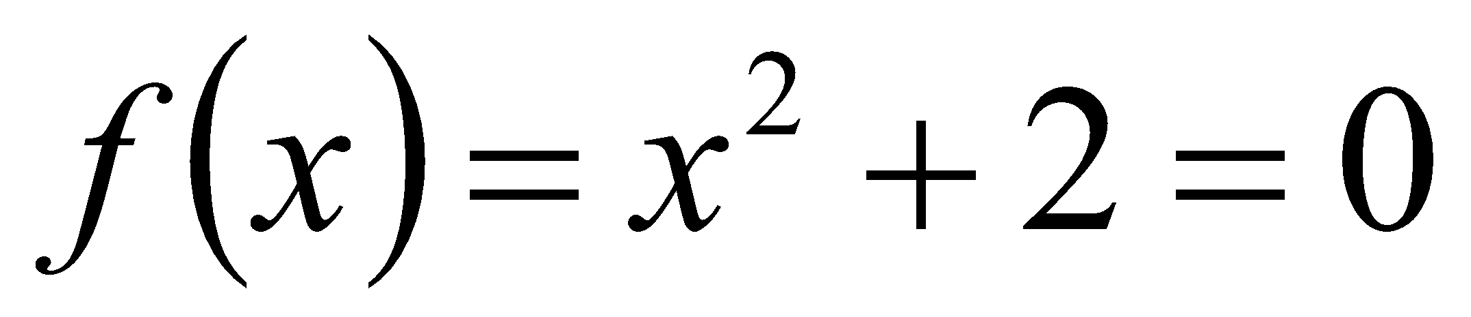
Drawbacks – Oscillations near local maximum and minimum
3. Oscillations near local maximum and minimum
Results obtained from the Newton-Raphson method may oscillate about the local maximum or minimum without converging on a root but converging on the local maximum or minimum.
Eventually, it may lead to division by a number close to zero and may diverge.
For example for the equation has no real roots.
‹#›

Slide 27
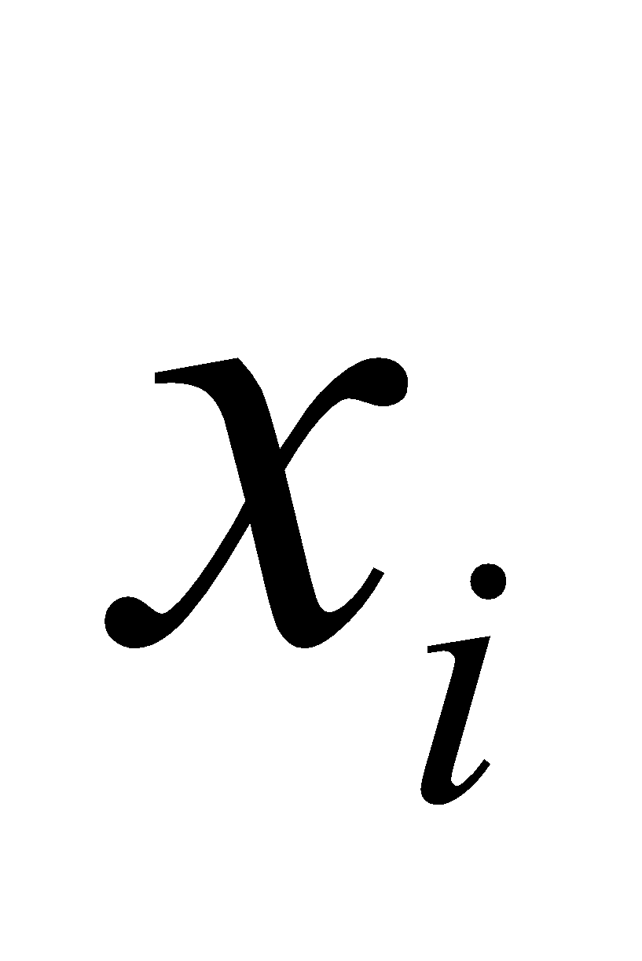
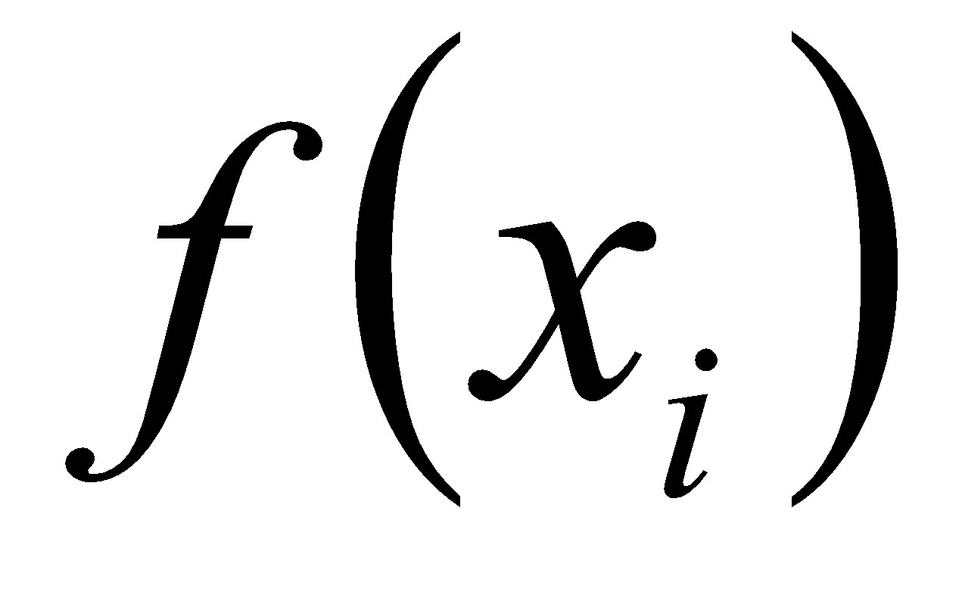
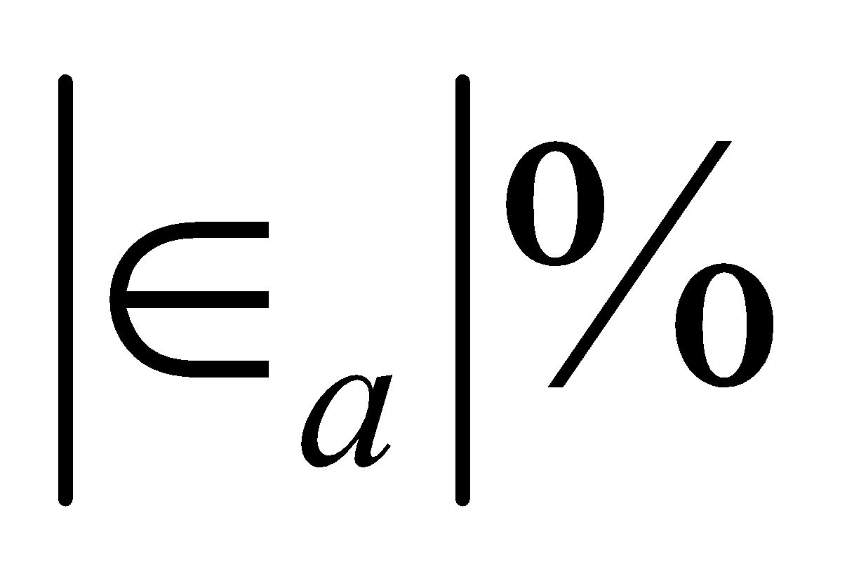


Drawbacks – Oscillations near local maximum and minimum
Table 3 Oscillations near local maxima and mimima in Newton-Raphson method.
Iteration Number
0 1 2 3 4 5 6 7 8 9 | –1.0000 0.5 –1.75 –0.30357 3.1423 1.2529 –0.17166 5.7395 2.6955 0.97678 | 3.00 2.25 5.063 2.092 11.874 3.570 2.029 34.942 9.266 2.954 | 300.00 128.571 476.47 109.66 150.80 829.88 102.99 112.93 175.96
Figure 10 Oscillations around local minima for .
‹#›

Slide 28







Drawbacks – Root Jumping
4. Root Jumping
In some cases where the function is oscillating and has a number of roots, one may choose an initial guess close to a root. However, the guesses may jump and converge to some other root.
For example
Choose
It will converge to
instead of
Figure 11 Root jumping from intended location of root for
.
‹#›

Slide 29
THE END
Notes:
‹#›

